Slide 1

COLLEGE ANTHEM
I pledge allegiance to the Lamb
With all my strength, With all I am
I will seek to honor His command
I pledge allegiance to the Lamb
I have heard how Christians long ago
Where brought before a tyrant’s throne
And they were told that he would spare their lives
If there would renounce the Name of Christ
But one by one they chose to die
The Son of God they would not deny
Like a great angelic choir they sing
I can almost hear their voices ring

Slide 2
COLLEGE ANTHEM cont'd
I pledge allegiance to the Lamb
With all my strength, With all I am
I will seek to honor His command
I pledge allegiance to the Lamb
Now the years have come, And the years have gone
But the course of Jesus still goes on
And now our time has come, To count the cost
To reject this world, to embrace the cross
And one by one, let us live our lives
For the one who die to give us life
Till the trumpet sounds on the final day
Let us proudly stand and boldly say

Slide 3
COLLEGE ANTHEM cont'd
I pledge allegiance to the Lamb
With all my strength, With all I am
I will seek to honor His command
I pledge allegiance to the Lamb
To the Lamb of God, Who bore my pain
Who took my pains, Who wore my shame
I will seek to honor His command
I pledge allegiance to the Lamb

Slide 4
COLLEGE PLEDGE
(DECLARATION OF FAITH)
1. I vow that my life will be governed by the throne of God
2. I am driven by the value system of Heaven; I evaluate the natural from the realm of spirit reality.
3. Where ever I am, I will pursue and defend the interest of Jesus my Master
4. I look forward to a glorious resurrection; to live or die for Jesus my Lord
5. I pledge my heart, my emotions, my mind, my will… I love you Jesus

Slide 5
CHURCH HISTORY SURVEY
INSTRUCTOR:
Rev'd. Ogidi, Daniel A.

Slide 6
CHURCH HISTORY SURVEY
Definitions of Church:
The Word Church is from the Greek word ekklesia
Which is also from two Greek words
(ek) – out of, or from
(kaleo) – to call
Thus, ekklesia means the called out, an assembly

Slide 7
CHURCH HISTORY SURVEY
Definitions of Church:
And I say also unto thee, That thou art Peter, and upon this rock I will build my church; and the gates of hell shall not prevail against it.
Matt. 16:18
Thus, The Church is the earthly expression of the Government of the Heavens

Slide 8
CHURCH HISTORY SURVEY
Definitions of Church:
m
But if I tarry long, that thou mayest know how thou oughtest to behave thyself in the house Aof God, which is the church of the living God, the pillar and ground of the truth.
1 Tim. 3:15
(1) The house of God,
(2) The church of the living God,
(3) The pillar and ground of the truth.

Slide 9
CHURCH HISTORY SURVEY
Definitions of Church History:
Church history or the history of the Church is the historical account of the Church from its inception to date
Church history is the historical account of the dealings of God among His people in human history
Church history is the historical account of the activities of the Church in the midst of human civilizations in time

Slide 10
CHURCH HISTORY SURVEY
It is important to study history because:
z
It is very important to
know and remember the way God has led His people in the past
in order to understand and have perspective for God’s currently dealings and
to also draw lessons for the future
And thou shalt remember all the way which the LORD thy God led thee… Deu. 8:2

Slide 11
CHURCH HISTORY SURVEY
Church history is conventionally studied from the day of Pentecost in the Acts of the Apostles. However, in this course, it will be survey from the very beginning – Genesis
a
This is because:
The Church existed since the OT (Acts 7:1,37-38) as a shadow, (Col.2:16-17)
The OT God is the same as the NT God, only that His dealings may slightly vary in time
Thus, the beginning of church history began from the very beginning

Slide 12
CHURCH HISTORY SURVEY
The act of creation involves:
Bringing into being from non-being,
Bringing into existence from non-existence,
To make something out of nothing without using pre-existing materials

Slide 13
CHURCH HISTORY SURVEY
Who created the creator?

Slide 14
CHURCH HISTORY SURVEY
There are two broad categories of things that exist:
Uncreated beings – necessary beings, beings who do not derive their existence and purpose from things outside of themselves (God)
Created beings – contingent beings: creatures who are derivatives, whose existence and purpose depends on something other than and outside of themselves (humans, spirits, animals & plants, non-living things)

Slide 15
CHURCH HISTORY SURVEY
In the beginning God created the heavens and the earth…
Genesis 1:1 (WEB)
Note:
Did God create from pre-existing materials (water and earth)?
It was creation ex-nihilo, John 1:3
Both the physical and the spiritual entities were brought into being at creation, Col. 1:16-17

Slide 16
CHURCH HISTORY SURVEY
CREATION (c. 6,000 BC)
n
Note further that:
The first time words where used, it was not for communication but for creation, Gen. 1:3
There is creative power in words – watch your words and ensure to be creating the right things
God created the physical Universe in six days, Gen. 2:2; Ex. 20:11; 31:17
The last thing God created was REST on the seventh day, Gen. 2:2-3
The purpose of the creation of man was Kingdom Dominion, and Fellowship (Gen. 1:26-28; 3:8)
Fall of man Gen. 3
  Rebellion, Gen. 3:11-12
  Promise, Gen. 3:15

Slide 17
CHURCH HISTORY SURVEY
NEW Beginning
Call through the obedience of faith, Gen. 12:1; 15:5-6; James 2:23 (c. 2,083 BC)
Covenant, Gen. 13:16; 15:17-18; 22:17
Nationhood, Ex. 12:1-2; 13:4; De 16:1
Priesthood, Ex 19:6; 40:15
Rebellion
The kingdom split in two following the death of King Solomon
Judgment & Exile

Slide 18
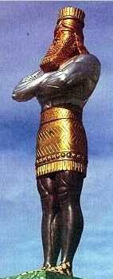
CHURCH HISTORY SURVEY
World Government
Daniel 2:1,19-44

Slide 19
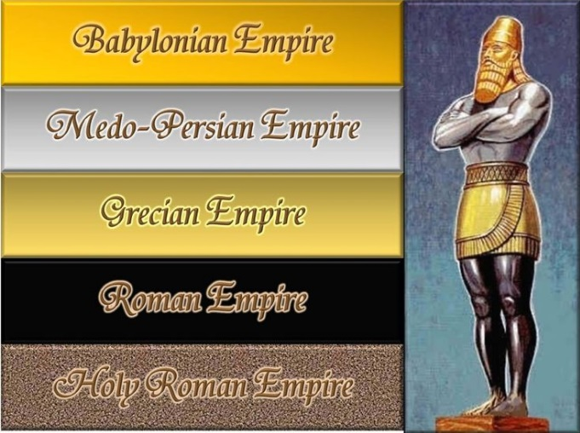
CHURCH HISTORY SURVEY
World Government
Judgment: exile

Slide 20
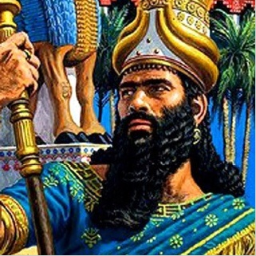
CHURCH HISTORY SURVEY
World Government
BABYLONIAN EMPIRE
Emperor: Nebuchadnezzar
Empire: Babylon
Policy: Exile

Slide 21
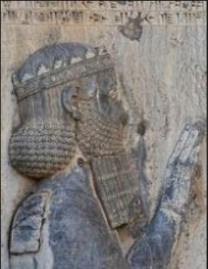
CHURCH HISTORY SURVEY
World Government
MEDO-PERSIAN EMPIRE (Daniel 5:30-31)
Emperor: Darius
Empire: Median
Policy: Exile

Slide 22
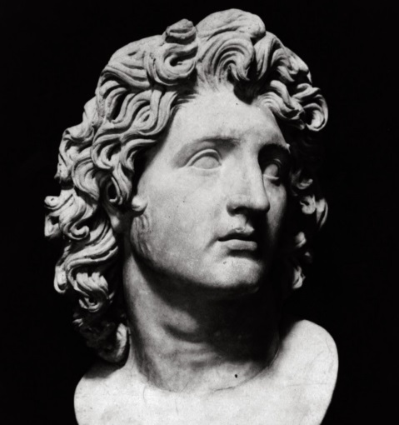
CHURCH HISTORY SURVEY
World Government
MACEDONIAN EMPIRE
Emperor: Alexander
Empire: Greece
Policy: Enculturation

Slide 23
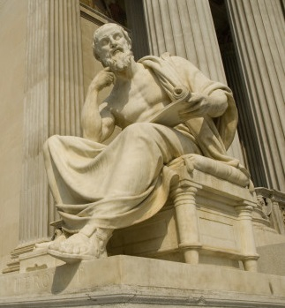
CHURCH HISTORY SURVEY
World Government
MACEDONIAN EMPIRE
Greek Philosophical Worldview
Dualism
Matter Vs Immaterial
Matter – evil
Immaterial – good

Slide 24
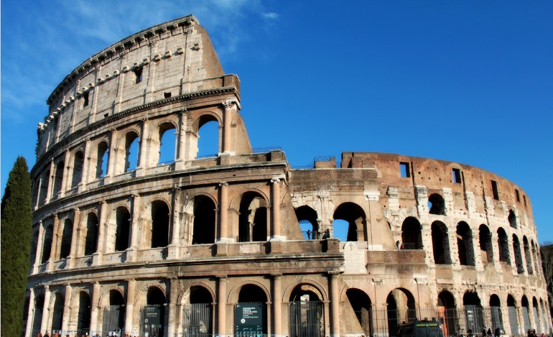
CHURCH HISTORY SURVEY
World Government
ROMAN EMPIRE
Emperor: Caeser
Empire: Rome
Policy: Colonization

Slide 25
CHURCH HISTORY SURVEY
World Government
Concept of the Fullness of Time
Gal. 4:4 (ROMAN EMPIRE)
Strategic type of government - COLONIZATION
Unified culture
(Language - GREEK)

Slide 26
CHURCH HISTORY SURVEY
Intertestamental/Second Temple period
Silent (400) years
Canonization of the OT Scriptures
Translation of the Septuagint – Greek OT (250-160 B.C.)
Apocryphal texts

Slide 27
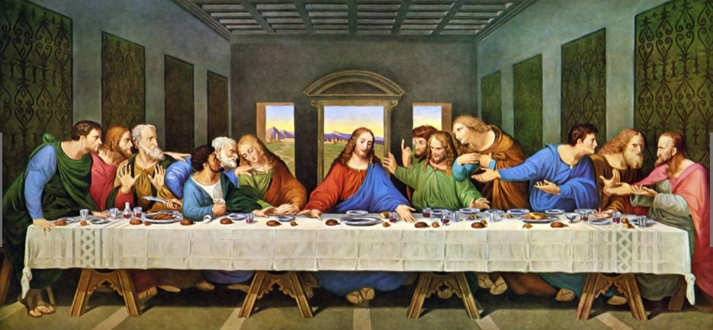
CHURCH HISTORY SURVEY
New Testament - Birth of the Church
Death and Resurrection of Christ: Institution of the Ordinance of Baptism and communion table

Slide 28
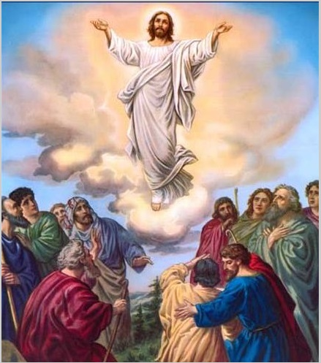
CHURCH HISTORY SURVEY
New Testament - Birth of the Church
Ascension: About 500 people were asked to wait for the coming and Baptism of the Holy Ghost

Slide 29
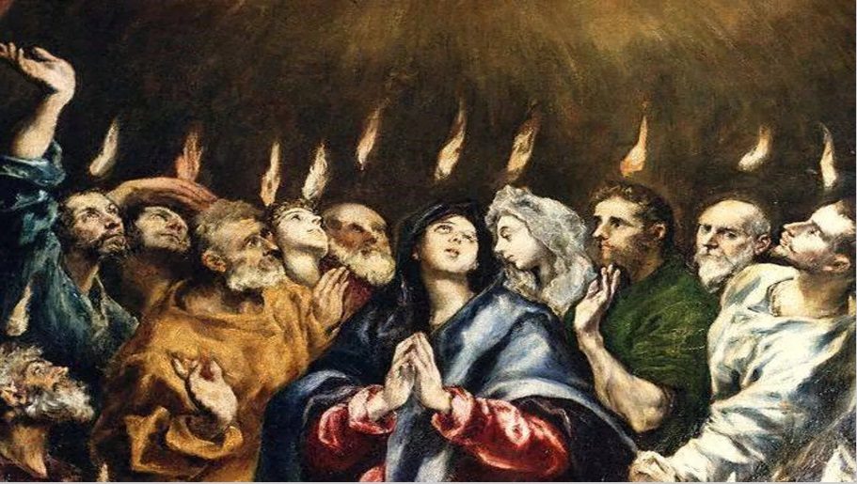
CHURCH HISTORY SURVEY
New Testament - Birth of the Church
Day of Pentecost: It is considered to be the official date of Birth of the Church (30AD). Only 120 people were patient enough to wait and receive. The rest 380 people have more pressing or important things to do. 1Cor. 15:1-6

Slide 30
CHURCH HISTORY SURVEY
General Church Eras
Jesse Lyman Hurlbut
1. THE APOSTOLIC CHURCH
From Ascension of Christ, 30 A.D.,
To the Death of St. John, 100 A.D.
2. THE PERSECUTED CHURCH
From the Death of St. John, 100 A.D.,
To the Edict of Constantine, 313 A.D.
3 .THE IMPERIAL CHURCH
From the Edict of Constantine, 313 A.D.,
To the Fall of Rome, 476 A.D.
4. THE MEDIEVAL CHURCH
From Fall of Rome, 476 A.D.,
To the Fall of Constantinople, 1453 A.D.
5. THE REFORMED CHURCH
From the Fall of Constantinople, 1453 A.D.
To the End of the Thirty Years’ War, 1648 A.D.
6. THE MODERN CHURCH
From the End of the Thirty Years’ War, 1648 A.D.
To the Twenty First Century, 2019 A.D.

Slide 31
CHURCH HISTORY SURVEY
THE PERSECUTED CHURCH (100 A.D. - 313 A.D.)
Reasons for Persecuting the Church
Rejection of Idol Worship
Loyalty to Christ
Secret meetings
Equality in the Christian Church
Business interest

Slide 32
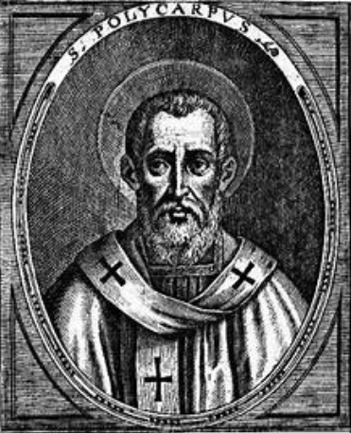
CHURCH HISTORY SURVEY
THE PERSECUTED CHURCH (100 A.D. - 313 A.D.)
2. Early Christian Martyrs
Polycarp, 155 A.D.
Justine, 166 A.D.
Leonidas, 202 A.D
Perpetua and Felicitas, 203 A.D

Slide 33
CHURCH HISTORY SURVEY
The Catechetical School in Alexandria and Antioch
The School at Alexandria and the School of Antioch in Syria - founded during the last half of the 3rd century - were the two major centres for the study of theology and Biblical exegesis in the Early Church.
Whereas the Didaskaleion at Alexandria, utilised the allegorical method for interpretation the Scriptures, complemented by a Christology that emphasised a union between man and God,
The School of Antioch championed a more literal (occasionally typological) or historical exegesis and a Christology depicting the distinction between man and God in the person of Jesus (McGrath 2013:32; cf. Coptic Orthodox Church Network 2012).

Slide 34
CHURCH HISTORY SURVEY
THE PERSECUTED CHURCH (100 A.D. - 313 A.D.)
The School at Alexandria presented three main courses, namely: (1) a special course for non-Christians, which introduced them to principles of Christianity, (2) a course on Christian morals and (3) an advanced course on divine wisdom and sufficient knowledge for the spiritual Christian.
The School did not only teach the students how to become Christians but also showed it to them in practice. The students were taught how to practise prayer, how to fast and how to practise different ways of asceticism. Besides purity and integrity, they were also encouraged to observe the celibacy

Slide 35
CHURCH HISTORY SURVEY
THE CHURCH FATHERS
Greek Fathers
m
1. Justin Martyr
Justin Martyr was an early Christian apologist, and is regarded as the foremost interpreter of the theory of the Logos in the 2nd century. He was martyred, alongside some of his students
2. Irenaeus of Lyons
Irenaeus was bishop of Lugdunum in Gaul, which is now Lyon(s), France. His writings were formative in the early development of Christian theology, and he was a notable early Christian apologist. He was also a disciple of Polycarp. His best-known book, Against Heresies (c.180) he enumerated heresies and attacked them. Irenaeus wrote that the only way for Christians to retain unity was to humbly accept one doctrinal authority—episcopal councils. Irenaeus proposed that the Gospels of Matthew, Mark, Luke and John all be accepted as canonical.

Slide 36
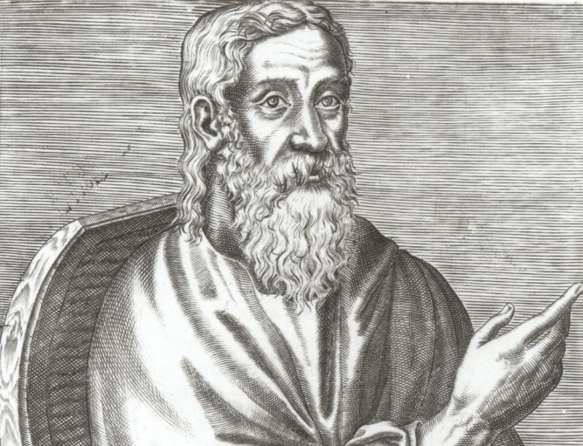
CHURCH HISTORY SURVEY
THE CHURCH FATHERS
Greek Fathers
m
3. Clement of Alexandria (c. 150 – c. 215)
Clement of Alexandria was the first member of the church of Alexandria to be more than a name, and one of its most distinguished teachers. He united Greek philosophical traditions with Christian doctrine and valued gnosis that with communion for all people could be held by common Christians. He developed a Christian Platonism. Like Origen, he arose from Catechetical School of Alexandria and was well versed in pagan literature.

Slide 37
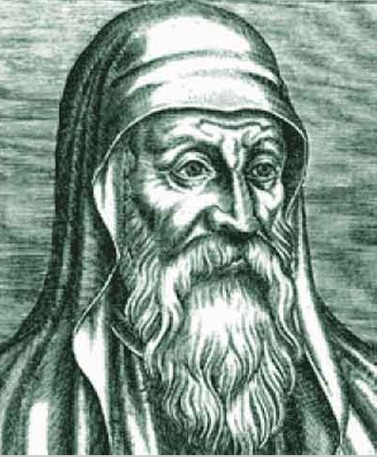
CHURCH HISTORY SURVEY
THE CHURCH FATHERS
Greek Fathers
m
4. Origen of Alexandria (c. 185 – c. 254)
Origen, or Origen Adamantius (c. 185 – c. 254) was a scholar and theologian. According to tradition, he was an Egyptian who taught in Alexandria, reviving the Catechetical School where Clement had taught. The patriarch of Alexandria at first supported Origen but later expelled him for being ordained without the patriarch's permission. He relocated to Caesarea Maritima and died there after being tortured during a persecution. He was later anathematised and some of his writings condemned as heretical.

Slide 38
CHURCH HISTORY SURVEY
THE CHURCH FATHERS
Greek Fathers
m
4. Origen of Alexandria (c. 185 – c. 254)
Using his knowledge of Hebrew, he produced a corrected Septuagint.
He wrote commentaries on all the books of the Bible.
In Peri Archon (First Principles), he articulated the first philosophical exposition of Christian doctrine.
He interpreted scripture allegorically and showed himself to be a stoic, a Neo-Pythagorean, and a Platonist.
Like Plotinus, he wrote that the soul passes through successive stages before incarnation as a human and after death, eventually reaching God.
He imagined even demons being reunited with God. For Origen, God was not Yahweh but the First Principle, and Christ, the Logos, was subordinate to him.

Slide 39
CHURCH HISTORY SURVEY
THE CHURCH FATHERS
Greek Fathers
m
4. Origen of Alexandria
viii His views of a hierarchical structure in the Trinity, the temporality of matter, "the fabulous preexistence of souls", and "the monstrous restoration which follows from it" were declared anathema in the 6th century.

Slide 40
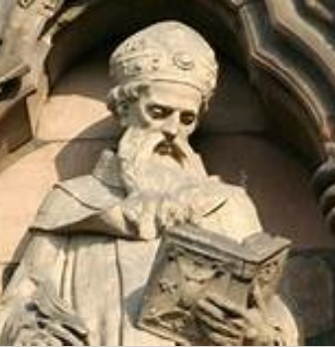
CHURCH HISTORY SURVEY
THE CHURCH FATHERS
Greek Fathers
m
5. Athanasius of Alexandria
Athanasius of Alexandria (c. 293 – 373) was a theologian, Pope of Alexandria, and a noted Egyptian leader of the 4th century. He is remembered for his role in the conflict with Arianism and for his affirmation of the Trinity. At the First Council of Nicaea (325), Athanasius argued against the Arian doctrine that Christ is of a distinct substance from the Father.

Slide 41
CHURCH HISTORY SURVEY
THE CHURCH FATHERS
Greek Fathers
m
5. Athanasius of Alexandria
He gave a list of exactly the same books as what would become the 27-book NT canon, and he used the word "canonized" (kanonizomena) in regard to them.
Canonization is not earlier than 300 A.D.

Slide 42
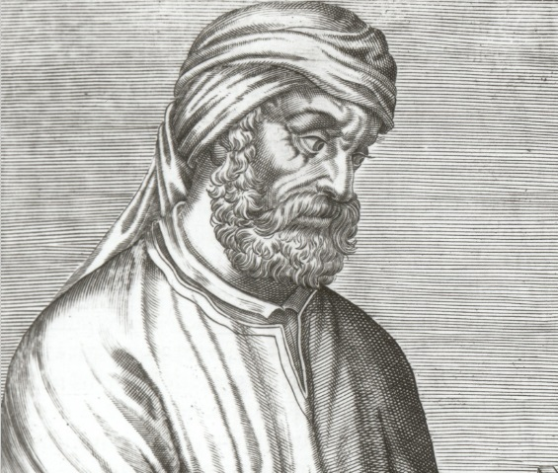
CHURCH HISTORY SURVEY
THE CHURCH FATHERS
Latin Fathers
m
1. Tertullian (c. 160 – c. 225)
Quintus Septimius Florens Tertullianus (c. 155 – c. 222), who was converted to Christianity before 197, was a prolific writer of apologetic, theological, controversial and ascetic works. He was born in Carthage, the son of a Roman centurion.

Slide 43
CHURCH HISTORY SURVEY
THE CHURCH FATHERS
Latin Fathers
m
1. Tertullian (c. 160 – c. 225)
Tertullian denounced Christian doctrines he considered heretical, such as allowing widows to remarry and permitting Christians to flee from persecution, but later in life adopted Montanism, regarded as heretical by the mainstream Church, which prevented his canonization.
He wrote three books in Greek and was the first great writer of Latin Christianity, thus sometimes known as the "Father of the Latin Church".

Slide 44
CHURCH HISTORY SURVEY
THE CHURCH FATHERS
Latin Fathers
m
1. Tertullian
c) He was evidently a lawyer in Rome. He is said to have introduced the Latin term trinitas with regard to the Divine (Trinity) to the Christian vocabulary and also probably the formula "three Persons, one Substance" as the Latin "tres Personae, una Substantia" (itself from the Koine Greek "τρεῖς ὑποστάσεις, ὁμοούσιος; treis Hypostases, Homoousios"), and also the terms vetus testamentum (Old Testament) and novum testamentum (New Testament).
d) In his Apologeticus, he was the first Latin author who qualified Christianity as the vera religio, and systematically relegated the classical Roman imperial religion and other accepted cults to the position of mere "superstitions".
e) Later in life, Tertullian joined the Montanists, a heretical sect that appealed to his rigorism.

Slide 45
CHURCH HISTORY SURVEY
THE CHURCH FATHERS
Latin Fathers
m
1. Tertullian
f) He used the early church's symbol for fish—the Greek word for "fish" being ΙΧΘΥΣ which is an acronym for Ἰησοῦς Χριστός, Θεοῦ Υἱός, Σωτήρ (Jesus Christ, God's Son, Saviour)—to explain the meaning of baptism since fish are born in water. He wrote that human beings are like little fish.
2. Cyprian of Carthage
Cyprian (c. 200 – 258) was bishop of Carthage and an important early Christian writer. He was born in North Africa, probably at the beginning of the 3rd century, perhaps at Carthage, where he received an excellent classical (pagan) education. After converting to Christianity, he became a bishop and eventually died a martyr at Carthage. He emphasized the necessity of the unity of Christians with their bishops, and also the authority of the Roman See, which he claimed was the source of "priestly unity"'.

Slide 46
CHURCH HISTORY SURVEY
THE CHURCH FATHERS
Latin Fathers
m
3. Ambrose of Milan
Ambrose was an archbishop of Milan who became one of the most influential ecclesiastical figures of the 4th century. He was a governor before becoming bishop. He is counted as one of the four original doctors of the Church.

Slide 47
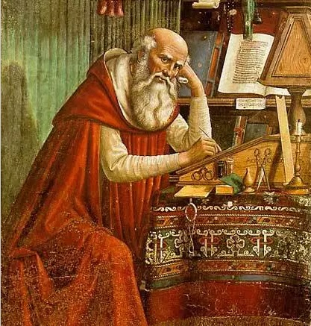
CHURCH HISTORY SURVEY
THE CHURCH FATHERS
Latin Fathers
m
4. Jerome of Stridonium
Jerome (c. 347 – 420) is best known as the translator of the Bible from Greek and Hebrew into Latin in 382. He also was a Christian apologist. Jerome's edition of the Bible, the Vulgate, is still an important text of Catholicism. He is recognised by the Roman Catholic Church as a Doctor of the Church.

Slide 48
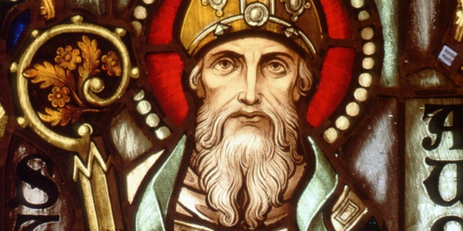
CHURCH HISTORY SURVEY
THE CHURCH FATHERS
Latin Fathers
m
5. Augustine of Hippo
Augustine (354–430), Bishop of Hippo, was a philosopher and theologian. Augustine, a Latin Father and Doctor of the Church, is one of the most important figures in the development of Western Christianity. In his early life, Augustine read widely in Greco-Roman rhetoric and philosophy, including the works of Platonists such as Plotinus.

Slide 49
CHURCH HISTORY SURVEY
THE CHURCH FATHERS
Latin Fathers
m
5. Augustine of Hippo
Augustine was born in present-day Algeria to a Christian mother, Monica of Hippo. He was educated in North Africa and resisted his mother's pleas to become Christian. He took a concubine and became a Manichean. He later converted to Christianity, became a bishop, and opposed heresies, such as Pelagianism.
His many works—including The Confessions, which is often called the first Western autobiography—have been read continuously since his lifetime.
He framed the concepts of original sin and just war as they are understood in the West.

Slide 50
CHURCH HISTORY SURVEY
THE CHURCH FATHERS
Latin Fathers
m
5. Augustine of Hippo
When Rome fell and the faith of many Christians was shaken, Augustine wrote The City of God, in which he defended Christianity from pagan critics and developed the concept of the Church as a spiritual City of God, distinct from the material City of Man.
The Roman Catholic religious order, the Order of Saint Augustine, adopted his name and way of life. Augustine is also the patron saint of many institutions and a number have been named after him.

Slide 51
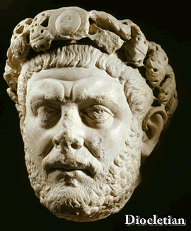
CHURCH HISTORY SURVEY
THE PERSECUTED CHURCH (100 A.D. - 313 A.D.)
Diocletian division of empire: West & East
When he split up the leadership of the Roman Empire in 286, Diocletian continued to rule in the East. He made Maximian his equal and co-emperor in the west. They were each called Augustus which signified that they were emperors.
In 293, the two emperors decide to name additional leaders who could take over for them in the case of their deaths. Subordinate to the emperors were the two Caesars: Galerius, in the east, and Constantius (the father of Constantine) in the west.

Slide 52
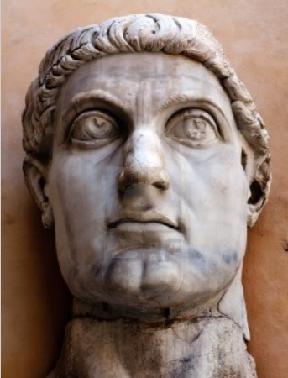
CHURCH HISTORY SURVEY
THE IMPERIAL CHURCH (313 A.D. – 476 A.D.)
Emperor Constantine
c. 272 AD - 22 May 337 AD)
Edict of Milan
Restoration of Church properties
Building of new Capital

Slide 53
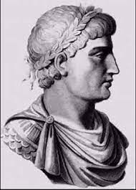
CHURCH HISTORY SURVEY
THE IMPERIAL CHURCH (313 A.D. – 476 A.D.)
Emperor Theodosius I (347 - 395)
On February 27, 380, in Thessaloniki, the Eastern Roman Emperor Theodosius I signed a decree in the presence of the Western Roman Emperor Valentinian II (371 - 392) that made Christianity the religion of the state and punished the practice of pagan rituals

Slide 54
CHURCH HISTORY SURVEY
Definitions of Heresy (by Jack Zavada)
According to Tyndale Bible Dictionary, the Greek word hairesis, meaning "choice," designates a sect or faction.
The term heresy came to designate divisions, schisms, and factions which held divergent opinions within the early church. As Christianity grew and developed, the church established the basic teachings of the faith. Those basics can be found in the Apostles' Creed and Nicene Creed.
Over the centuries, however, theologians and religious figures have proposed doctrines that contradict established Christian beliefs. To keep those beliefs pure, the church singled out people who taught or believed ideas considered a threat to Christianity.
Today, the word heresy expresses any teaching that might cause a believer to break away from orthodoxy or the accepted views of the community of faith.

Slide 55
CHURCH HISTORY SURVEY
Definitions of Orthodox (by Leonidas Contos)
The term Orthodox combines the adjective orthos, which means right, correct or true, and the noun doxa, which comes from the verb doxazo, "I hold an opinion," or "I believe." Hence "right belief," or "true doctrine." But in a deeper sense it also means "right worship," since doxazo can also mean "I glorify."
It could be said that the term Orthodox was forged as a defense against heretical, or heterodox, teaching which persisted during the formative centuries.
As then, so now, it signifies a framework of theological propositions worked into precise doctrinal formulations, a body of faith and a tradition, that has retained its absolute integrity in the face of the changes and innovations that have occurred within Christianity.
Far from merely describing form, it goes to the very essence of Orthodoxy, namely that it adheres with absolute fidelity to the principles and piety, the beliefs and Tradition of the early, undivided Church Catholic.

Slide 56
CHURCH HISTORY SURVEY
Benefits of Heresy (by Jacob Reaume)
1. Heresy brings truth to the fore. Often truth is taken for granted. The Church moves on assuming the truth. The assumption can lead to forgetfulness. But when heresy emerges, Christians are forced to think things through and take nothing for granted. When errors surface the saints are forced to spot them. Upon recognizing error they proceed to articulate the truth as a remedy to the error. Truth shines most radiant against the dark backdrop of lies
2. Heresy sends people to the Bible. When the average Christian hears that pastor or doctor so and so is accused of being a false teacher, they are forced to decide. Do they or do they not believe the accusation? To evaluate the situation Christians will search the Scriptures like the Bereans. They examined “the Scriptures daily to see if these things were so” (Acts 17:11). It is not enough to ask whether the person in question is likeable, whether he can quote scholars, or whether he has credentials. The Spirit prompts the truly converted to open the Bible, and that’s always a good thing

Slide 57
CHURCH HISTORY SURVEY
Benefits of Heresy (by Jacob Reaume)
3. Heresy shows the true Christians. How do we recognize true Christians? They hear the voice of Jesus and obey Him (John 10:27). Jesus was very clear that there will be many false converts. Many will believe they are converted but truly are not. Controversy is a time when the sheep separate from the goats. The goats leave for error (1 John 2:19), but the faithful remain.
4. Heresy forces the Church into unity. Some people naively think church unity means that we get along with whoever calls himself a Christian. That’s false. Many people call themselves Christians but are agents of Satan sent to deceive. Paul mandates Christian unity and tells the Corinthians to “all” “agree” and to “be united in the same mind and same judgment” (1 Corinthians 1:10). That’s not primarily an organizational or denominational unity, nor is it a unity with anyone who claims to be a brother or sister in Christ. Rather it is a unity of agreement, of like-mindedness, and of conviction. If someone calls himself a Christian but resolutely contradicts foundational truth, the Church is stronger to separate from him. Such divisions are not divisions among Christians but rather between light and darkness, Christ and Satan.

Slide 58
CHURCH HISTORY SURVEY
Benefits of Heresy (by Jacob Reaume)
5. Heresy serves future generations. The theological controversies of past generations serve the Church for perpetuity. For example the Nicene Creed of 325 AD was forged in theological controversy. Arianism ravaged the Church, and it had to be repudiated. Nicaea did just that. It clarified orthodoxy. 1700 years later, it still serves us well.

Slide 59
CHURCH HISTORY SURVEY
HERESIES AND CHURCH COUNCILS
Trinitarian Heresies
Christological Heresies and Church Councils

Slide 60
CHURCH HISTORY SURVEY
Chapter and Verse Division of the Bible
The chapter divisions commonly used today were developed by Stephen Langton, an Archbishop of Canterbury. Langton put the modern chapter divisions into place in around A.D. 1227.
The Hebrew Old Testament was divided into verses by a Jewish rabbi by the name of Nathan in A.D. 1448.
Robert Estienne, who was also known as Stephanus, was the first to divide the New Testament into standard numbered verses, in 1555. Stephanus essentially used Nathan's verse divisions for the Old Testament. The first translation to employ his versification was the Geneva translation of 1557 (whole Bible, 1560)

Slide 61
CHURCH HISTORY SURVEY
THE MEDIEVAL CHURCH (476 A.D. - 1453 A.D.)
The Great Schism (1054)
The Great Schism, also known as the East-West Schism, was the event that divided "Chalcedonian" Christianity into
  Western (Roman) Catholicism and
  Eastern Orthodoxy.
Though normally dated to 1054, when Pope Leo IX and Patriarch Michael I excommunicated each other, the East-West Schism was actually the result of an extended period of estrangement between the two bodies of churches.

Slide 62
CHURCH HISTORY SURVEY
THE MEDIEVAL CHURCH (476 A.D. - 1453 A.D.)
Reasons for The Great Schism (1054)
Disputes in the Balkans over whether the Western or Eastern church had jurisdiction.
The designation of the Patriarch of Constantinople as ecumenical patriarch (which was understood by Rome as universal patriarch and therefore disputed).
Certain liturgical practices in the west that the East believed represented innovation: use of unleavened bread for the Eucharist, for example. Eastern innovations, such as intinction (dipping) of the bread in the wine for Communion, were condemned several times by Rome but were never the occasion of schism.

Slide 63
CHURCH HISTORY SURVEY
THE MEDIEVAL CHURCH (476 A.D. - 1453 A.D.)
Reasons for The Great Schism (1054) cont'd
Disputes over whether the Patriarch of Rome, the Pope, should be considered a higher authority than the other Patriarchs. All five Patriarchs of the One Holy Catholic and Apostolic Church agreed that the Patriarch of Rome should receive higher honors than the other four; they disagreed about whether he had authority over the other four and, if he did, how extensive that authority might be.

Slide 64
CHURCH HISTORY SURVEY
THE MEDIEVAL CHURCH (476 A.D. - 1453 A.D.)
Reasons for The Great Schism (1054) cont'd
The concept of Caesaropapism, a tying together in some way of the ultimate political and religious authorities, which were physically separated much earlier when the capital of the empire was moved from Rome to Constantinople. There is controversy over just how much this so-called "Caesaropapism" actually existed and how much was a fanciful invention, centuries later, by western European historians.

Slide 65
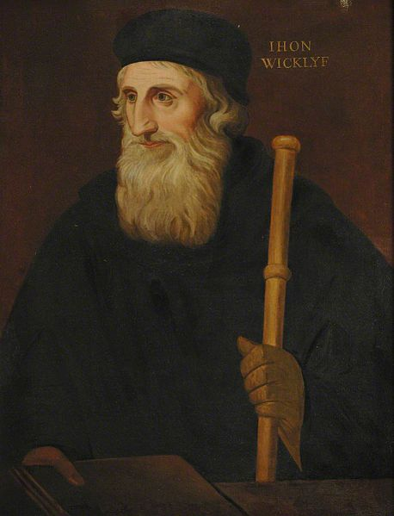
CHURCH HISTORY SURVEY
THE MEDIEVAL CHURCH (476 A.D. - 1453 A.D.)
John Wycliffe c. 1320s – 31 Dec 1384
An English scholastic philosopher, theologian, Biblical translator, reformer, priest, and a seminary professor at the University of Oxford. He became an influential dissident within the Roman Catholic priesthood during the 14th century and is considered an important predecessor to Protestantism.
Wycliffe also advocated translation of the Bible into the vernacular. In 1382 he completed a translation directly from the Vulgate into Middle English – a version now known as Wycliffe's Bible.

Slide 66
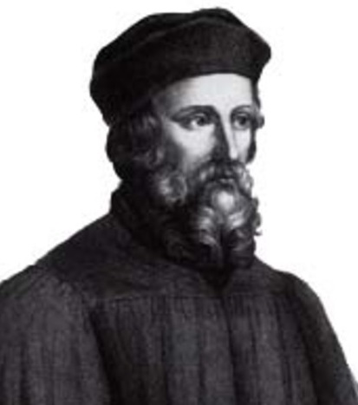
CHURCH HISTORY SURVEY
THE MEDIEVAL CHURCH (476 A.D. - 1453 A.D.)
Jan Hus (c. 1369 – 6 July, 1415)
sometimes Anglicized as John Hus or John Huss, also referred to in historical texts as Iohannes Hus or Johannes Huss, was a Czech theologian, philosopher, master, dean, and rector of the Charles University in Prague who became a church reformer, an inspirer of Hussitism, a key predecessor to Protestantism and a seminal figure in the Bohemian Reformation.

Slide 67
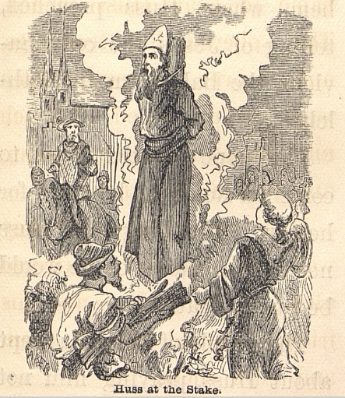
CHURCH HISTORY SURVEY
THE MEDIEVAL CHURCH (476 A.D. - 1453 A.D.)
Jan Hus (c. 1369 – 6 July, 1415)
Before his execution, Hus is said to have declared: “you may kill a weak goose (in Czech Hus means goose), but more powerful birds, eagles and falcons, will come after me”. Luther modified the statement and reported that Hus had said that they might have roasted a goose but in a hundred years a swan would have sung to whom they would have been forced to listen.

Slide 68
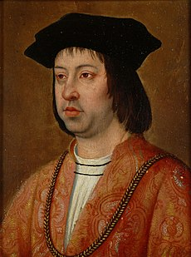
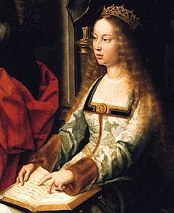
CHURCH HISTORY SURVEY
THE MEDIEVAL CHURCH (476 A.D. - 1453 A.D.)
THE INQUISITION (22 April 1451 – 26 Nov 1504)
The Tribunal of the Holy Office of the Inquisition (Spanish: Tribunal del Santo Oficio de la Inquisición), commonly known as the Spanish Inquisition (Inquisición española), was established in 1478 by Catholic Monarchs Ferdinand II of Aragon and Isabella I of Castile. It was intended to maintain Catholic orthodoxy in their kingdoms and to replace the Medieval Inquisition, which was under Papal control.

Slide 69
CHURCH HISTORY SURVEY
THE MEDIEVAL CHURCH (476 A.D. - 1453 A.D.)
THE INQUISITION (22 April 1451 – 26 Nov 1504)
According to modern estimates, around 150,000 were prosecuted for various offenses during the three-century duration of the Spanish Inquisition

Slide 70
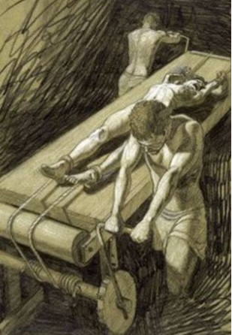
CHURCH HISTORY SURVEY
THE MEDIEVAL CHURCH (476 A.D. - 1453 A.D.)
Torture instruments of the INQUISITION
The accused person, when undergoing torture on the rack, would usually experience excruciating pain when they would be placed on the wooden framed rack with rollers on both the ends. With their ankles bound to one roller and wrists tied with the other, they would undergo brutal interrogation by men who would slowly turn the handle so as to crack their limbs. This torture method was one of the most painful among those used in the dark ages.

Slide 71
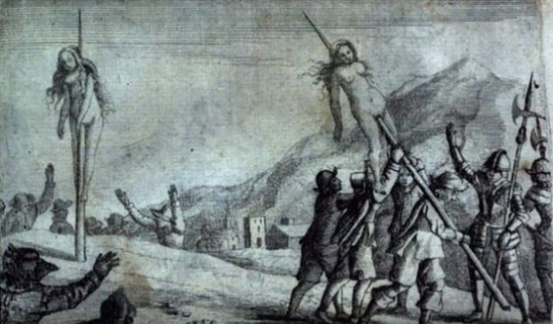
CHURCH HISTORY SURVEY
THE MEDIEVAL CHURCH (476 A.D. - 1453 A.D.)
Torture instruments of the INQUISITION
Torturing couldn’t have been more brutal and painful than impaling someone on a pole. This form of torture resulted in death. In Romania, accused men and women were forced to sit on pointed poles. The poles were then raised to force inside the anuses of the victims. The victims were left pierced and stayed alive for the next couple of days before breathing their last. It was a painful way of executing anyone.

Slide 72
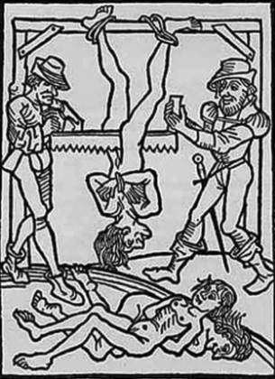
CHURCH HISTORY SURVEY
THE MEDIEVAL CHURCH (476 A.D. - 1453 A.D.)
Torture instruments of the INQUISITION
The Middle Ages were called Dark for a number of reasons, one among them being the severe and inhuman torture methods used to punish people. There were a number of ghastly torture devices for females as well as for males back then. One of the scariest devices used to torture women was the saw.. Sawing a woman or a man in half was a common thing Such women were usually sawed in half by hanging them upside down and with their legs spread out. Two men usually carried out the sawing that lasted for a long time. It was a very brutal and painful way of dying

Slide 73
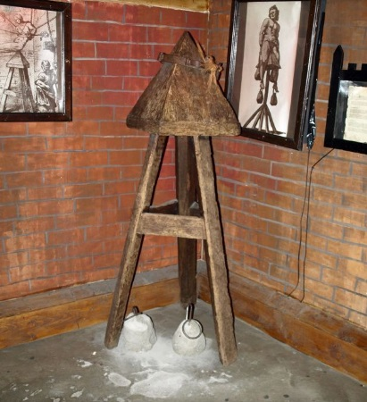
CHURCH HISTORY SURVEY
THE MEDIEVAL CHURCH (476 A.D. - 1453 A.D.)
Torture instruments of the INQUISITION
A very cruel invention by the Italians, the Judas Cradle was a torture device used primarily on women. It was a tool, the seat of which was shaped in the form of a pyramid. The victim, typically a woman, would be forced to sit on this seat with a pointed tip using a rope. The pressure would force the tip to insert the woman’s anus or vagina and tear her muscles from inside. To add more to this cruel torture, the woman’s heels would be tied down with weights. This would be done to inflict the maximum pain and damage

Slide 74
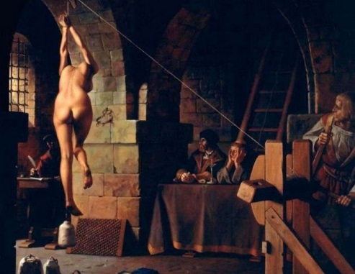
CHURCH HISTORY SURVEY
THE MEDIEVAL CHURCH (476 A.D. - 1453 A.D.)
Torture instruments of the INQUISITION
In this form of torture, women were suspended in air by tying their hands, and weights attached to their feet. This tore the back and shoulder muscles and caused immense pain, followed by death. It was a severe form of torture and any person undergoing it was hung naked for all to mock them. This torture was used widely during the Spanish Inquisition.

Slide 75
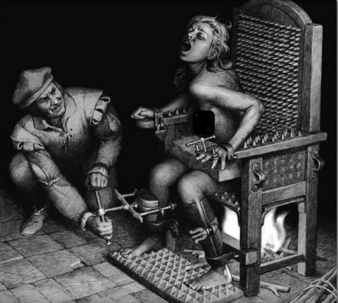
CHURCH HISTORY SURVEY
THE MEDIEVAL CHURCH (476 A.D. - 1453 A.D.)
Torture instruments of the INQUISITION
Meant for both men and women, the Iron Chair was a torture tool in which the victims were seated, only to be pierced by sharp edged spikes covering the chair. The torture lasted for several hours and days. This device was used widely in the Middle Ages to scare people to confess to crimes. Most of the times, victims died from blood loss

Slide 76
CHURCH HISTORY SURVEY
THE REFORMED CHURCH (1453 A.D. - 1648 A.D.)
Islam
he Islamic prophet Muhammad began receiving what Muslims consider to be divine revelations in 610 CE

Slide 77
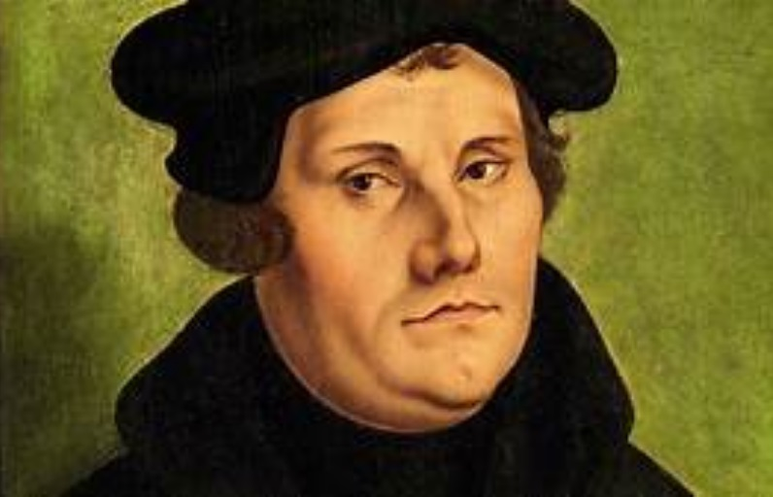
CHURCH HISTORY SURVEY
THE REFORMED CHURCH (1453 A.D. - 1648 A.D.)
Martin Luther (10 Nov 1483 – 18 Feb 1546)

Slide 78
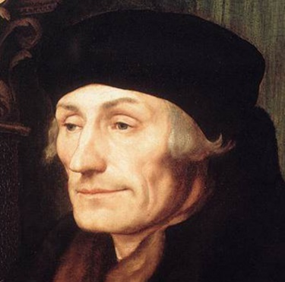
CHURCH HISTORY SURVEY
THE REFORMED CHURCH (1453 A.D. - 1648 A.D.)
Desiderius Erasmus Roterodamus (28 Oct 1466 – 12 July 1536),
known as Erasmus or Erasmus of Rotterdam

Slide 79
CHURCH HISTORY SURVEY
THE REFORMED CHURCH (1453 A.D. - 1648 A.D.)
Protestant Reformation
OCTOBER 31, 1517
The sale of indulgences
The 95 Thesis
The Duke's dream
Compare Jan Hus (c.1415)

Slide 80
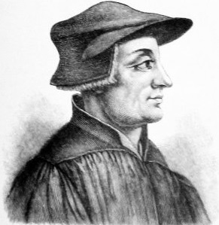
CHURCH HISTORY SURVEY
THE REFORMED CHURCH (1453 A.D. - 1648 A.D.)
Zwingli and the Anabaptists
Huldrych Zwingli or Ulrich Zwingli (1 Jan 1484 – 11 Oct 1531)

Slide 81
CHURCH HISTORY SURVEY
THE REFORMED CHURCH (1453 A.D. - 1648 A.D.)
Luther and the Jews
Martin Luther (10 Nov 1483 – 18 Feb 1546)

Slide 82
CHURCH HISTORY SURVEY
THE REFORMED CHURCH (1453 A.D. - 1648 A.D.)
Counter Reformation
Queen “Bloody” Mary
Hugh Latimer and his friend Nicholas Ridley
As they were both about to be burned as heretics for their teachings and beliefs outside Balliol College, Oxford (16 October 1555). Hugh Latimer To his friend Nicholas Ridley be of good comfort, Master Ridley, and play the man! We shall this day light such a candle, by God's grace, in England, as I trust shall never be put out

Slide 83
CHURCH HISTORY SURVEY
Chapter and Verse Division of the Bible
The chapter divisions commonly used today were developed by Stephen Langton, an Archbishop of Canterbury. Langton put the modern chapter divisions into place in around A.D. 1227.
The Hebrew Old Testament was divided into verses by a Jewish rabbi by the name of Nathan in A.D. 1448.
Robert Estienne, who was also known as Stephanus, was the first to divide the New Testament into standard numbered verses, in 1555. Stephanus essentially used Nathan's verse divisions for the Old Testament. The first translation to employ his versification was the Geneva translation of 1557 (whole Bible, 1560)

Slide 84
CHURCH HISTORY SURVEY
THE REFORMED CHURCH (1453 A.D. - 1648 A.D.)
Counter Reformation
Society of Jesus aka the Jesuit Order founded by Ignatius of Loyola and six companions with the approval of Pope Paul III in 1540

Slide 85
CHURCH HISTORY SURVEY
THE REFORMED CHURCH (1453 A.D. - 1648 A.D.)
1. Theories of Atonement
2. Doctrines that Divide

Slide 86
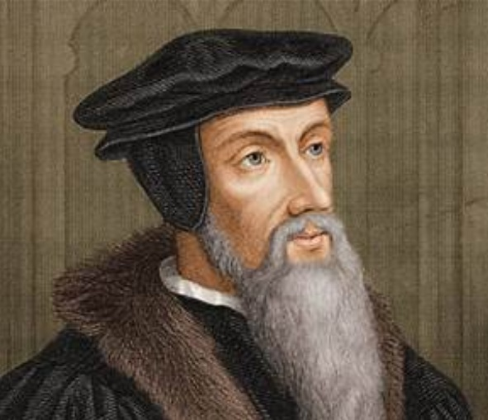
CHURCH HISTORY SURVEY
THE REFORMED CHURCH (1453 A.D. - 1648 A.D.)
John Calvin; born Jehan Cauvin; 10 July 1509 – 27 May 1564)

Slide 87
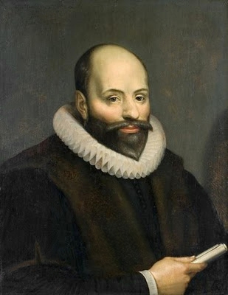
CHURCH HISTORY SURVEY
THE REFORMED CHURCH (1453 A.D. - 1648 A.D.)
Jacobus Arminius (Oct 10, 1560 – Oct 19, 1609)

Slide 88
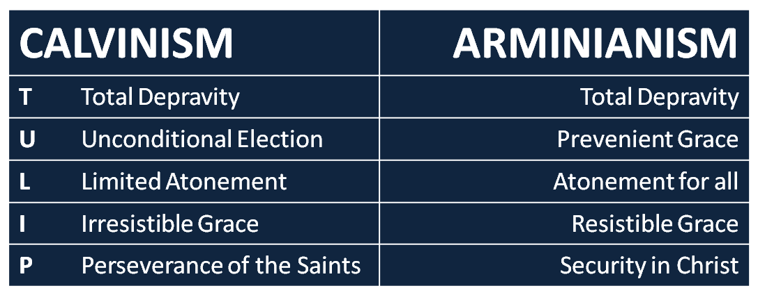
CHURCH HISTORY SURVEY
THE REFORMED CHURCH (1453 A.D. - 1648 A.D.)

Slide 89
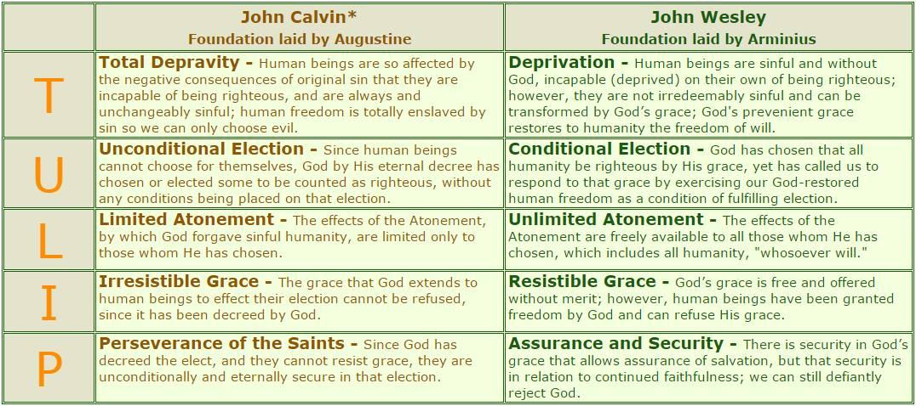
CHURCH HISTORY SURVEY
THE REFORMED CHURCH (1453 A.D. - 1648 A.D.)

Slide 90
CHURCH HISTORY SURVEY
Chapter and Verse Division of the Bible
The chapter divisions commonly used today were developed by Stephen Langton, an Archbishop of Canterbury. Langton put the modern chapter divisions into place in around A.D. 1227.
The Hebrew Old Testament was divided into verses by a Jewish rabbi by the name of Nathan in A.D. 1448.
Robert Estienne, who was also known as Stephanus, was the first to divide the New Testament into standard numbered verses, in 1555. Stephanus essentially used Nathan's verse divisions for the Old Testament. The first translation to employ his versification was the Geneva translation of 1557 (whole Bible, 1560)

Slide 91
CHURCH HISTORY SURVEY
Reference:
Hurlbut, Jesse Lyman. The Story of the Christian Church. Grand Rapids, Michigan: Zondervan, 1970.
b
Contos, Leonidas (2015) “Orthodox Theology - An Introduction” Greek Orthodox Archdiocese of America
m
Zavada, Jack (2019) “The Meaning of Heresy in Christianity” Learn Religions
m
Reaume, Jacob (2017) “What Good Can a Heretic Bring?” The Pastor's Blog

